Slide 1

Sprocket Central Pty Ltd
Data analytics approach
[Division Name] - [Engagement Manager], [Senior Consultant], [Junior Consultant]

Slide 2
Data Visualization using Tabelau
Gender Vs Past 3 yr Bike Purchased
Gender Vs Profit
Transaction Happen Online with profit and successful transaction.
Industry wise gender Distribution with profit.
State wise profit
State wise wealth and tenure

Slide 3
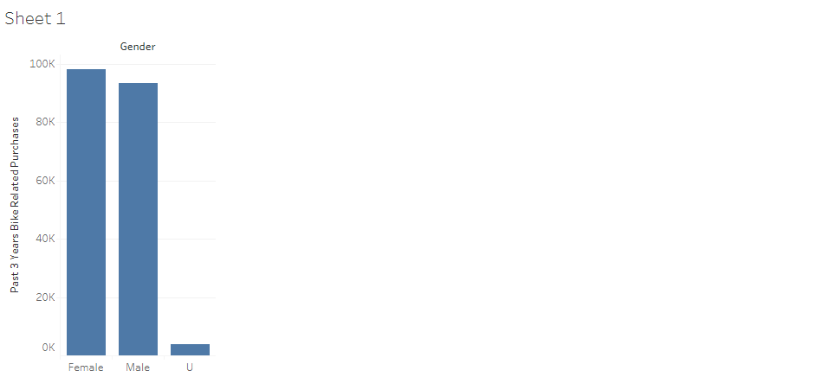
Gender Vs Past 3 yr Bike Purchased

Slide 4
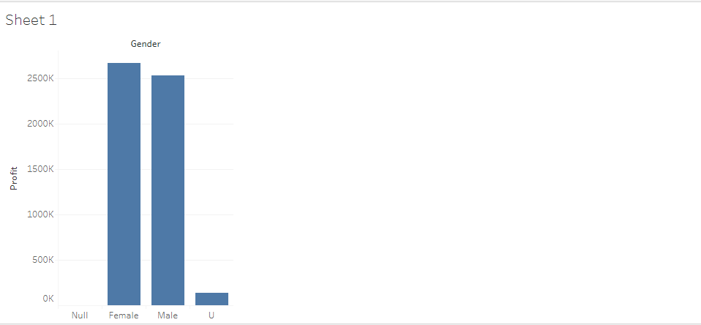
Gender Wise Profit

Slide 5
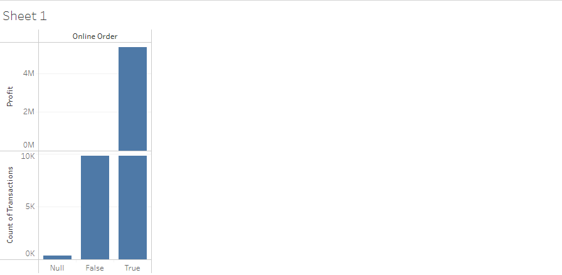
Online Transaction with profit and successful Transaction

Slide 6
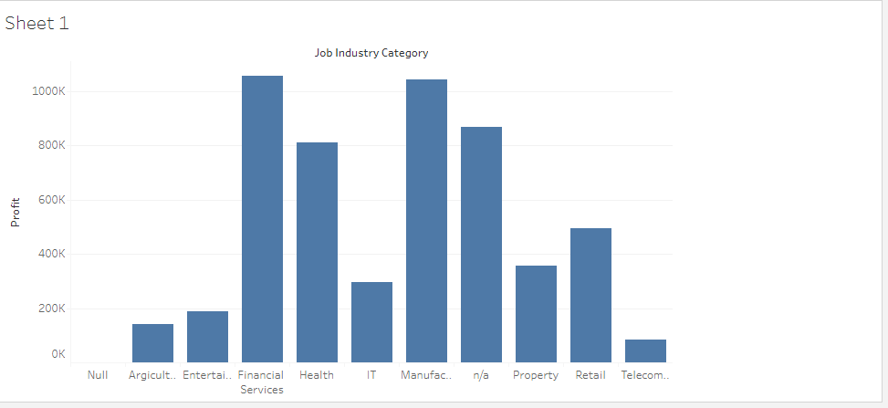
Industry Wise profit

Slide 7
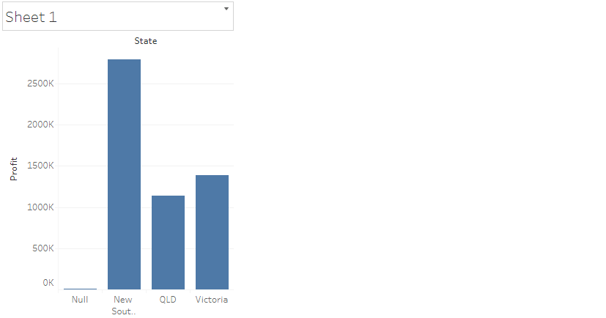
State Wise profit

Slide 8
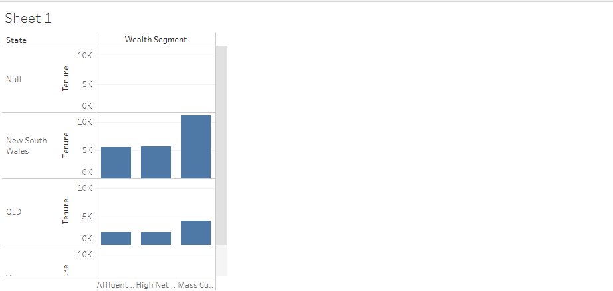
State wealth and tenure

